Slide 1
Recommendation Systems
By : Thevaki Paramalingam
Notes:
Good evening

Slide 2
What are Recommendation Systems?
Recommendation engines basically are data filtering tools that make use of algorithms and data to recommend the most relevant items to a particular user.
Recommendations are responsible for 70% of the time people spend watching videos on YouTube.
75% of what people are watching on Netflix comes from recommendations, according to McKinsey.
Therefore, a food recommendation system can be built for diabetes patients to recommend suitable food items.
Notes:
Recommendation system uses simple algorithms which aim to provide the most relevant and accurate items to the users by filtering useful stuffs.
3 phases
information gathering phse ,
implicit - user reviewing history or social media
explicit - system prompts

Slide 3
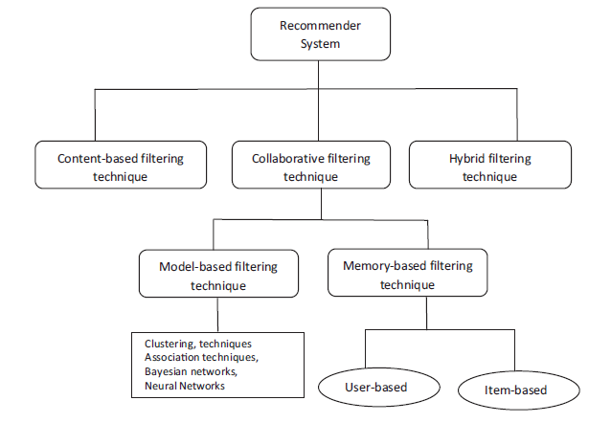
How most of the Recommendation Systems work?

Slide 4






Content based filtering
Already bought
Recommended

Slide 5






Collaborative filtering
Already bought
Recommended

Slide 6
Thank You

